Slide 1







The 2019 Stack Overflow Developer Survey Results
Aníbal José Ceballos Hurtado
November 2023
https://www.linkedin.com/in/anibalceballos/

Slide 2



OUTLINE
Executive Summary
Introduction
Methodology
Results
Visualization – Charts
Dashboard
Discussion
Findings & Implications
Conclusion
Appendix

Slide 3

EXECUTIVE SUMMARY
Data briefing
Methodology
Data gathering
Data analysis
Data visualizations
Results
Visualization – Charts
Dashboards
Discussion
Finding & implications
Conclusions
Appendix

Slide 4

INTRODUCTION
Stack Overflow’s annual Developer Survey is the largest and most comprehensive survey of people who code around the world.
A community-based space to find and contribute answers to technical challenges, and one of the most popular websites in the world.
Stack Overflow’s products and tools empower people to find what they need to develop technology at work or at home. The products include, Stack Overflow for Teams, Stack Overflow Advertising, Collectives™ on Stack Overflow, and Stack Overflow Talent.
For this Data Analysis Capstone Project software like Python and platform like IBM Cognos Analytics were used to gather, clean, explore and visualize data from the dataset.

Slide 5

METHODOLOGY
Data Sources and Data Collection techniques
Stack Overflow Developers Survey 2019 (Web Scraping)
GitHub Job Posting (APIs)
Programming Language Annual Salary (Request Library)
Data Wrangling (Python)
Cleaning data (duplicate rows, finding missing values, and data normalization)
Data Exploration (Python)
Analyzing Data Distribution
Handing Outliers
Correlation
Data Visualization (IBM Cognos Analytics)
Distribution, relationships, composition and comparison of data
Dashboards
Current Technology Usage
Future Technology Trends
Demographics

Slide 6

RESULTS

Slide 7
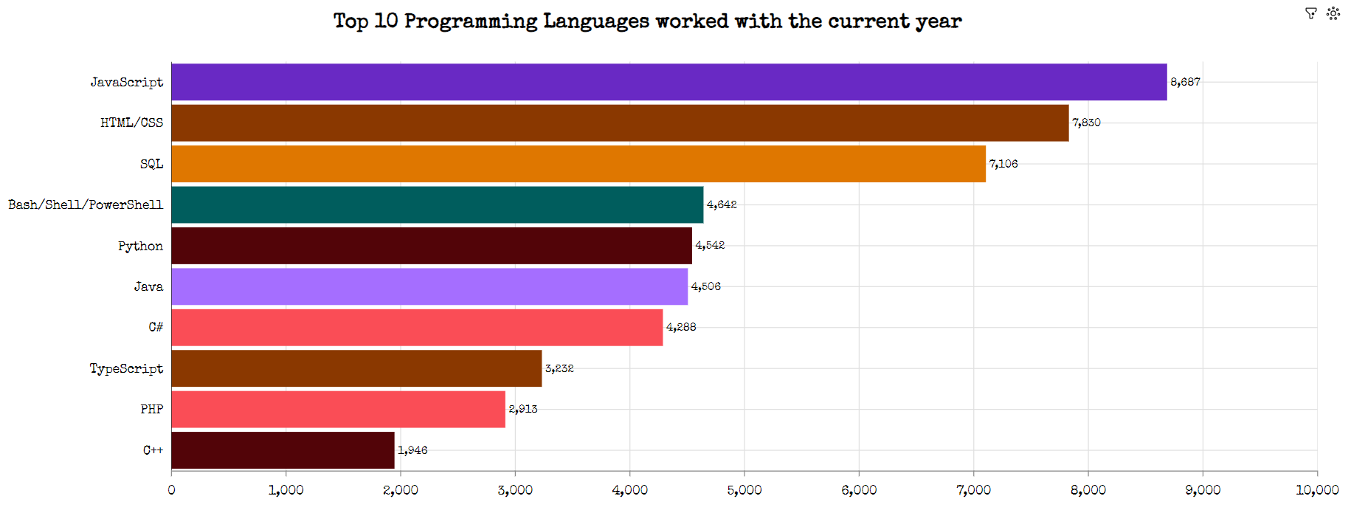
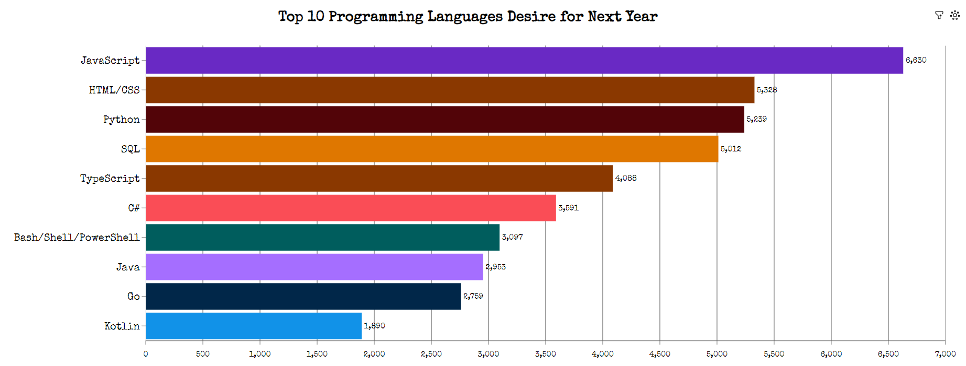
PROGRAMMING LANGUAGE TRENDS
Current Year
Next Year

Slide 8
PROGRAMMING LANGUAGE TRENDS - FINDINGS & IMPLICATIONS
JavaScript is the # 1 programming language.
Programmers has shown increased interest in Python and TypeScript.
Kotlin and Go has paved the way in the share market next year regarding high-level Programming Languages.
Powershell lost ground among respondents.
Web development is still field with a high demand.
Possible migration from JavaScript to TypeScript. Python is still considered as the best choice regarding AI and ML.
New options regarding Programming Languages has emerged in the sector.
Platforms like Google and Android are now being considered owing to their versatility and popularity of the mobile phones and tablets.

Slide 9
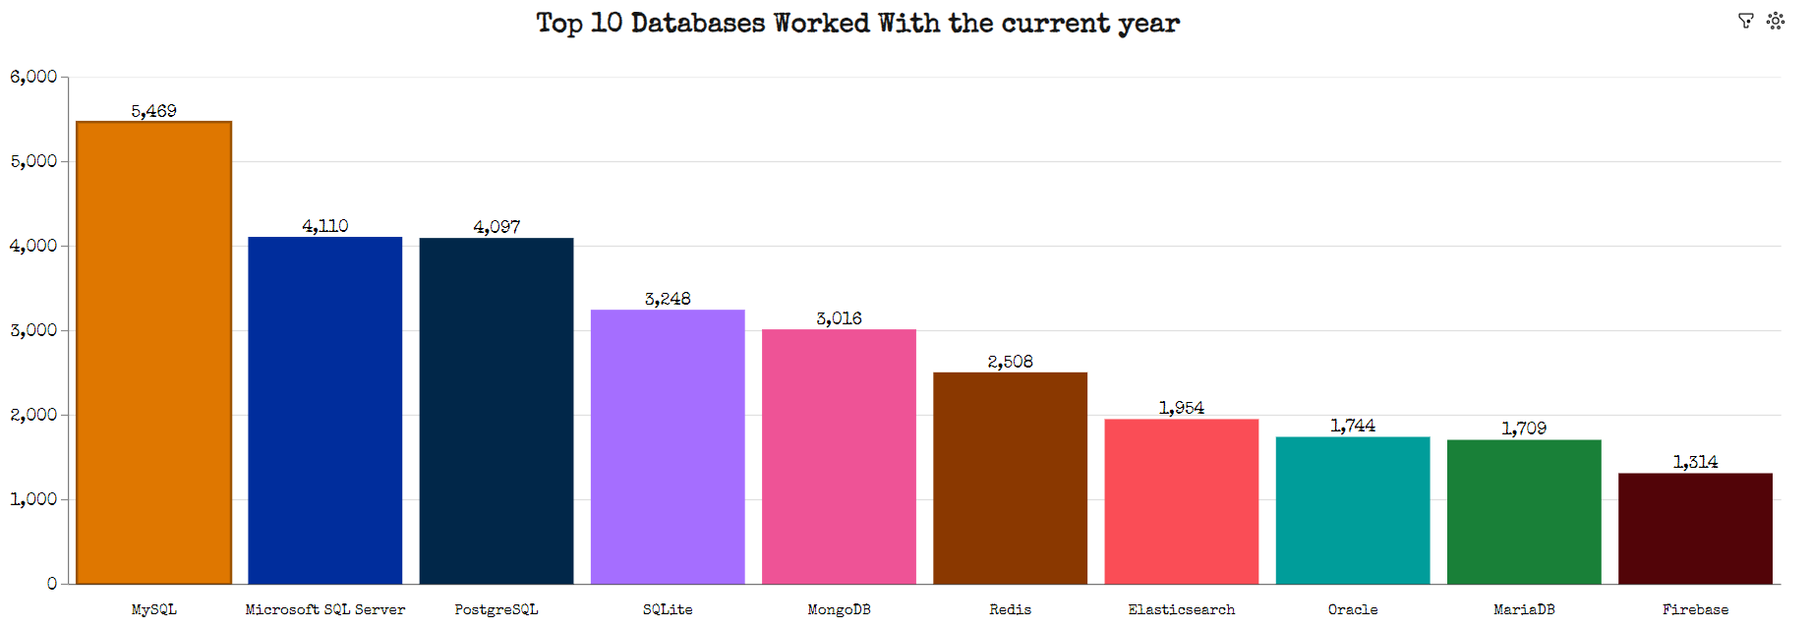
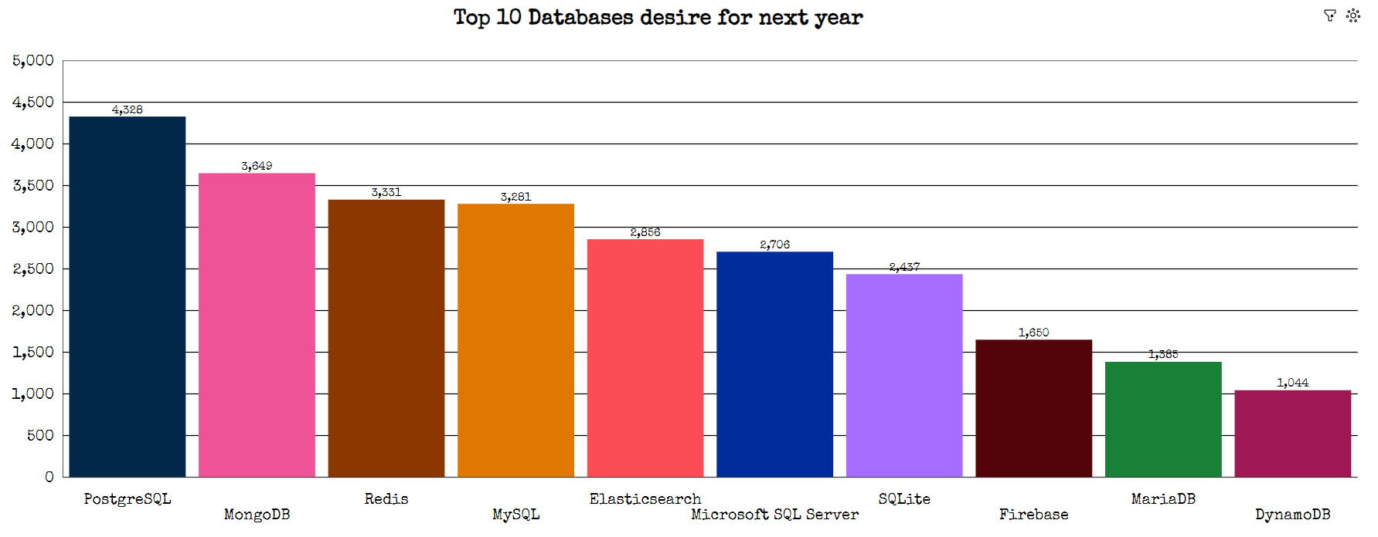
DATABASE TRENDS
Current Year
Next Year

Slide 10
DATABASE TRENDS - FINDINGS & IMPLICATIONS
MySQL was the most used Database this year.
My SQL and Microsoft SQL lost ground whereas PostgreSQL and MongoDB were ranked as the leading Databases for next year.
Oracle was edged out, Elastic Share and DynamoDB gained interest among programmers.
Open Source Databases are still in high demand within companies. It is clearly visible a switch pattern in the usage of relational Databases.
New options like DynamoDB has gained market regarding NoSQL databases.
Search engines and software libraries like Elasticsearch are going to the widely used next year.

Slide 11

DASHBOARD
https://us3.ca.analytics.ibm.com/bi/?perspective=dashboard&pathRef=.my_folders%2FCognos%2BDashboard%2BEmbedded&action=view&mode=dashboard&subView=model0000018be472620f_00000000

Slide 12
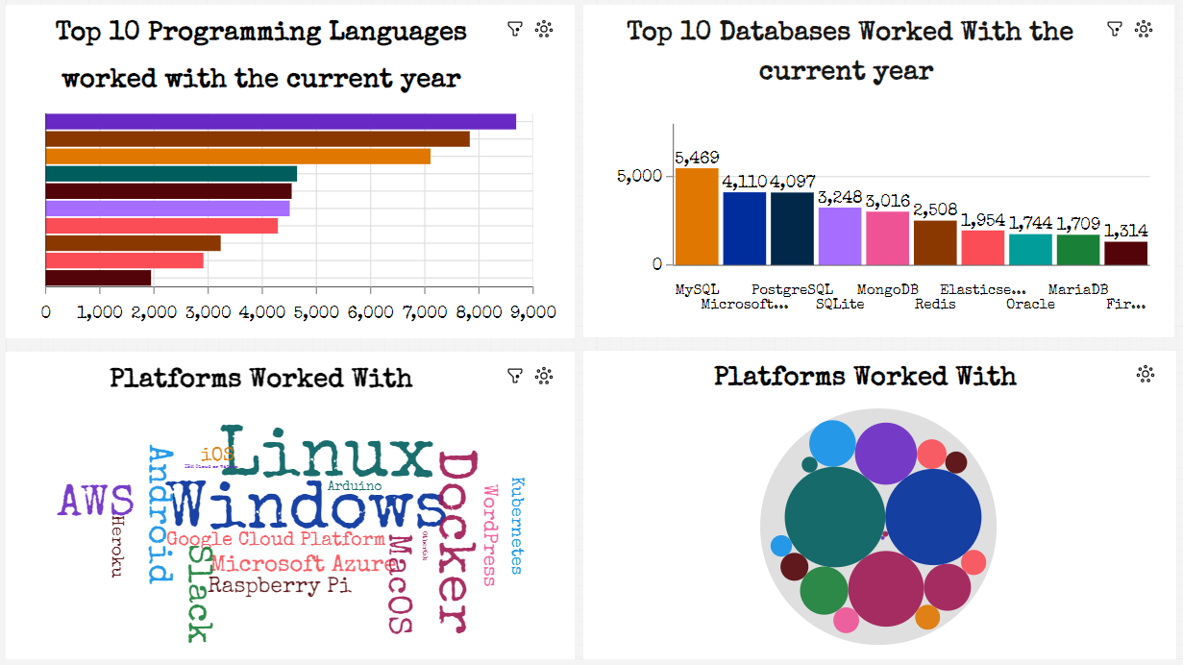
DASHBOARD TAB 1

Slide 13
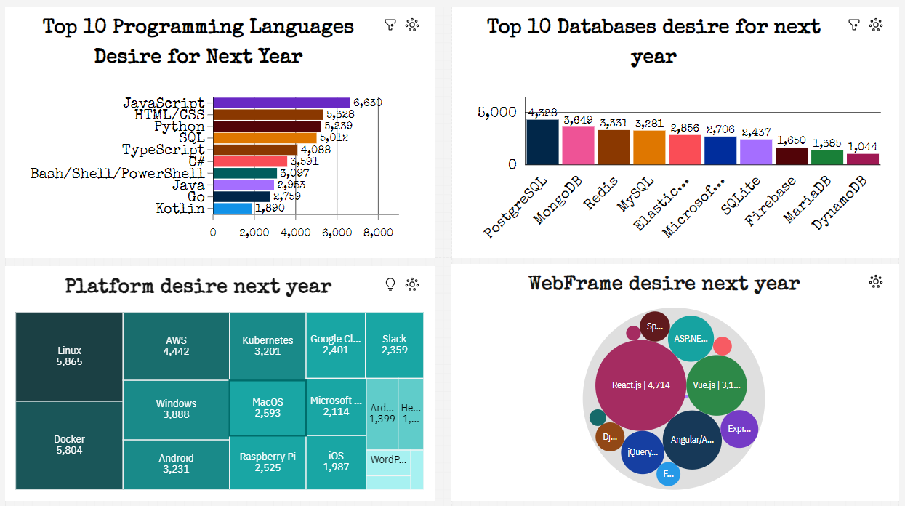
DASHBOARD TAB 2

Slide 14
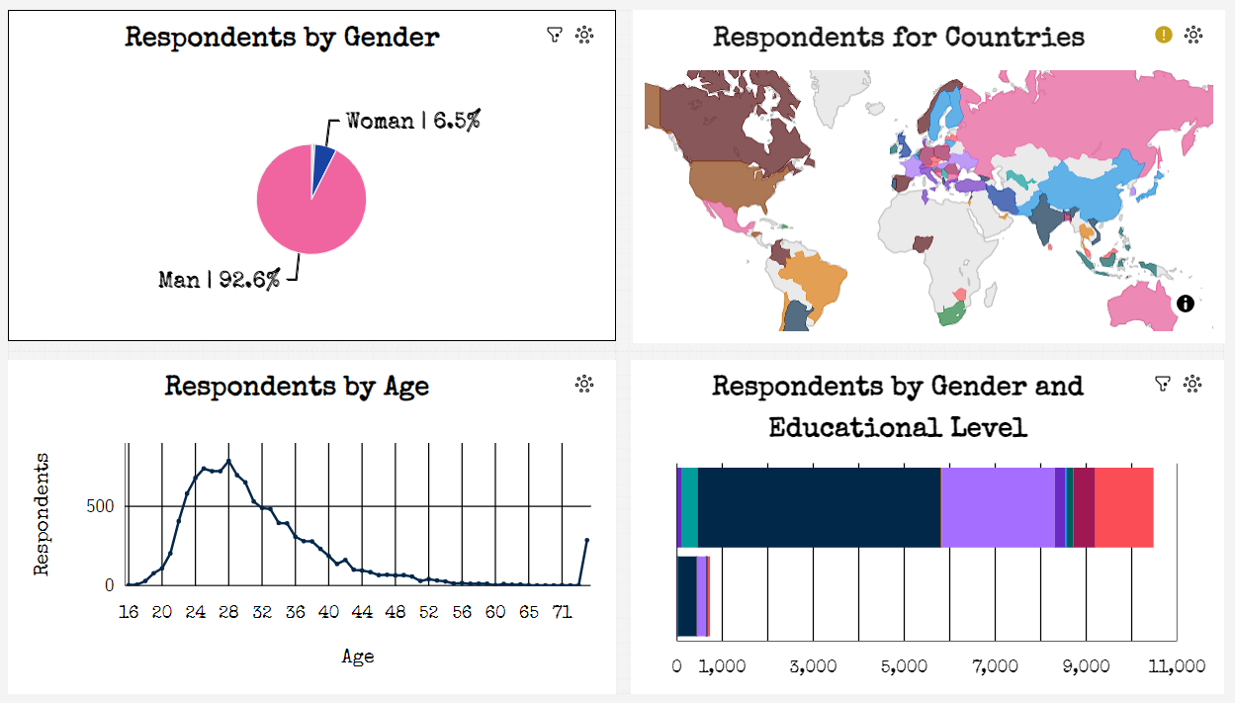
DASHBOARD TAB 3

Slide 15
DISCUSSION
Based on the charts and dashboards previously plotted via IBM Cognos analytics and Python via Anaconda Navigator, the most relevant findings and implications are going to be outlined below as well as the main conclusions of this Stack Overflow’s annual Developer Survey

Slide 16
OVERALL FINDINGS & IMPLICATIONS
Technologies are fast-changing every year.
U.S.A. India and the U.K. are the countries where most of the surveyed are based.
Male respondents accounts for 93.5% and female counterparts for 6.5% whose age range mostly lies within 20 – 35 years.
C programming language is the most demanded one as per job postings and Washington D.C. is the US location where most of the positions are offered.
Swift is the programming language with the highest salaries.
Linux, Docker, AWS, Windows and Android are the TOP # 5 platforms for next year.
Flexibility is highly required for companies to adapt to the fast changing market.
Developing countries should prioritize the technology sector both academically and professionally.
Age, gender and Educational level gaps should be bridged by governments and companies to make the technology sector more competitive and accessible.
Companies must have state of the art training to keep updated the personnel.
C programming language is and will continue be the # 1 option for companies. Swift is gaining room among programmers.
A change in pattern is seen regarding Platforms for the years to come.

Slide 17

CONCLUSION
A deeper and broader study is required for a better understanding of the technology sector.
Programming Languages, Databases and Demographic trends were obtained based on the surveyed people and their backgrounds.
Actions to be taken into consideration regarding Age, Gender and Educational Level.
Technology should focus on emerging countries where there is a big gap to fill.
Platforms are gaining room in the sector as the market is aiming to smartphone and tablets.
Fields like Machine Learning, Artificial Intelligence and Deep Learning should included in the coming surveys.

Slide 18

APPENDIX
Relevant additional charts were included to support the findings and conclusions outlined below.

Slide 19
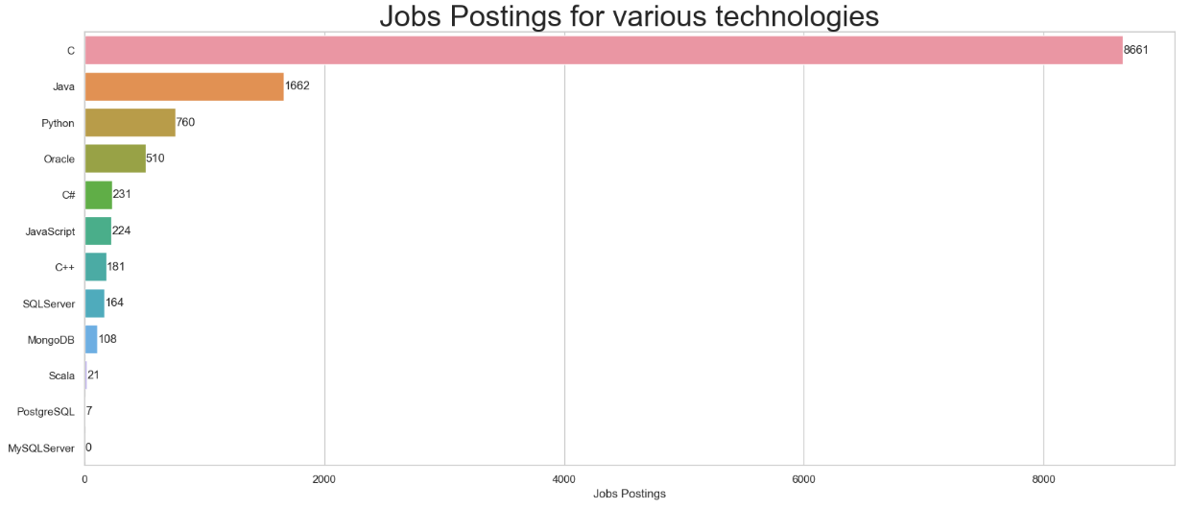
JOB POSTINGS PER POPULAR PROGRAMMING LANGUAGES

Slide 20
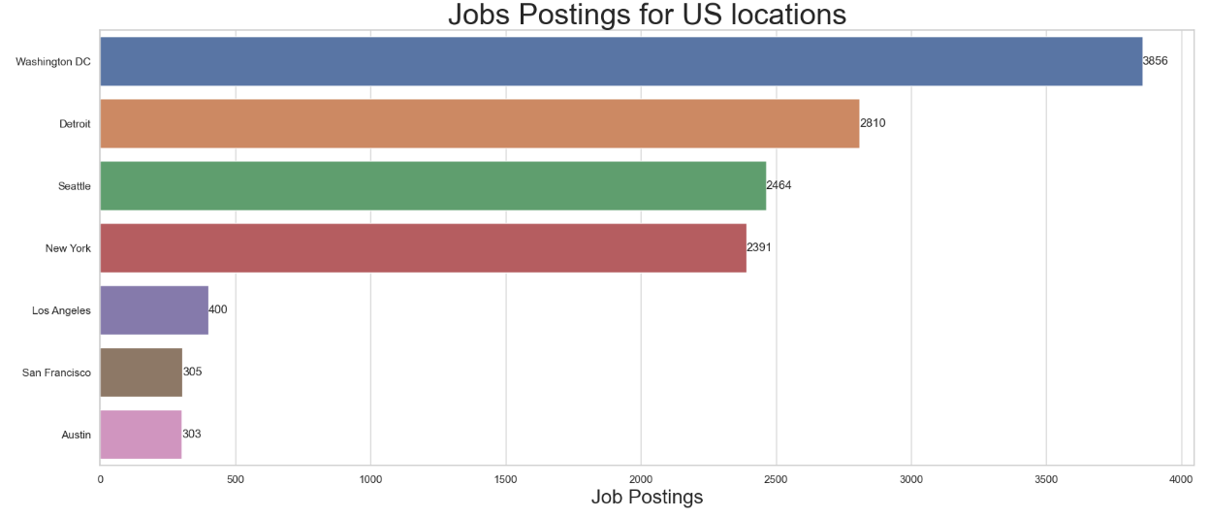
JOB POSTINGS FOR US LOCATIONS

Slide 21
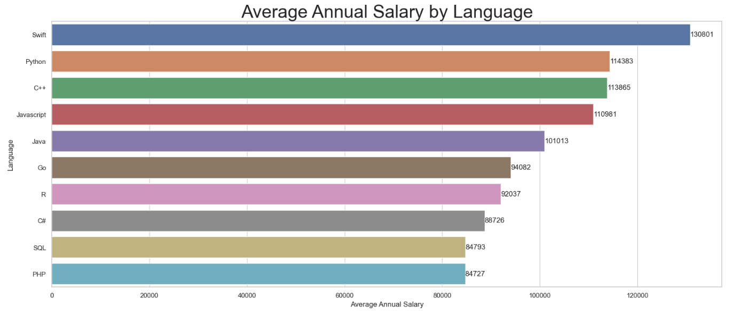
AVERAGE ANNUAL SALARY PER POPULAR PROGRAMMING LANGUAGES

Slide 22
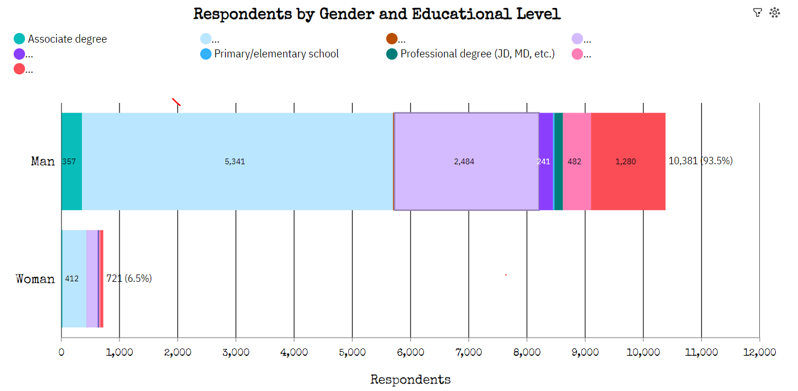
RESPONDENTS BY GENDER AND ED.LEVEL

Slide 23
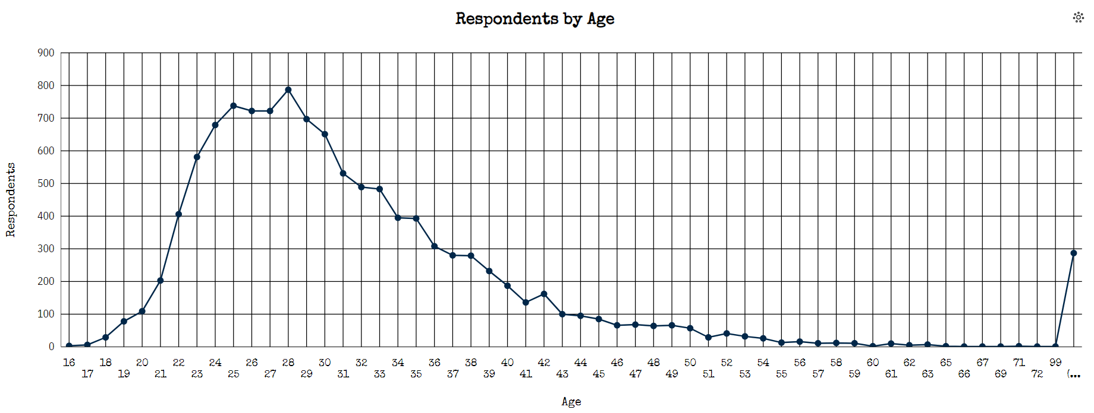
RESPONDENTS BY AGE

Slide 24
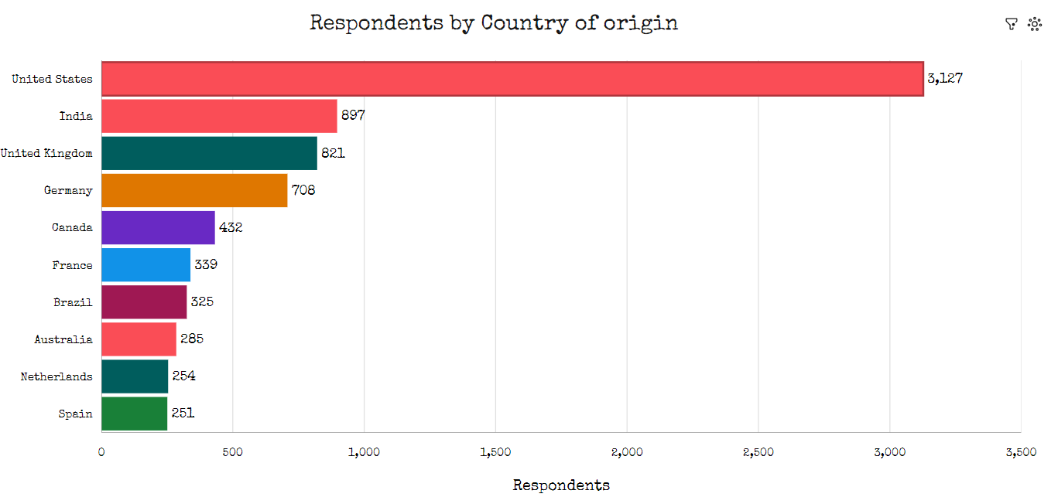
RESPONDENTS BY COUNTRY OF ORIGIN

